Slide 1

Retail Inventory Management and Forecasting
Digital Egypt Pioneers Initiative

Slide 2
Team members
Shahd Hesham
Mohamed Momen
Hedra Atif
Ahmed al dahi
Mostafa Mamdouh
Mohamed Ali
Abdulrahman Mahmoud

Slide 3
Agenda
INTRODUCTION
PURPOSE AND OBJECTIVES
TEAM RESPONSIBILITIES
DATABASE SYSTEM
DATA WAREHOUSE
ETL
DATA TRANSFORMATION
MACHINE LEARNING MODEL
DASHBOARD
DEPLOYMENT
TIMELINE

Slide 4

Introduction​
Retail businesses face significant challenges in managing inventory efficiently while meeting customer demands. Stockouts and overstocking can both hurt profitability and customer satisfaction. This project aims to address these issues by developing a Retail Inventory Management and Forecasting System that will help retail businesses track their inventory, monitor sales, and forecast future stock requirements. The system will be designed to provide real-time inventory visibility and accurate demand forecasting using SQL databases and cloud services like Azure.

Slide 5
tools
Software life cycle
1- Database Creation
Design database schema Create and populate SQL database Develop SQL Analysis queries
2- Processing Automation
Implement data warehouse Use ETL for data loading Write Python scripts for data extraction
Build forecasting model Utilize Azure for storage and analysis Evaluate the model
4- Visualization
3- Forecasting and Analysis
Using Power BI Final project report and documentation.
Microsoft SQL Server SSIS Python Azure MLOps
Azure Data Factory Azure Machine Learning Power BI

Slide 6
Team Responsibilities
Shahd: designing the SQL database schema, creating and filling the database with sample data, developing SQL queries for inventory tracking and sales reporting.
Hedra : Implement the data warehouse to ​merge inventory and sales data for reporting and analysis, Set up Azure connection, configure database and warehouse structure in azure.
Abdulrahman : Use ETL processes to integrate data into the warehouse.
Mostafa : Write Python scripts to extract data from the dataset, perform data cleaning, prepare it for analysis.
Mohamed Momen : Build forecasting models to predict inventory demand and evaluate how well the model predicts future inventory demand.
Mohamed Ali : Deploy the forecasting model into a MLOps using Azure Machine Learning.
Ahmed: Data Visualization using power bi

Slide 7

Database system

Slide 8
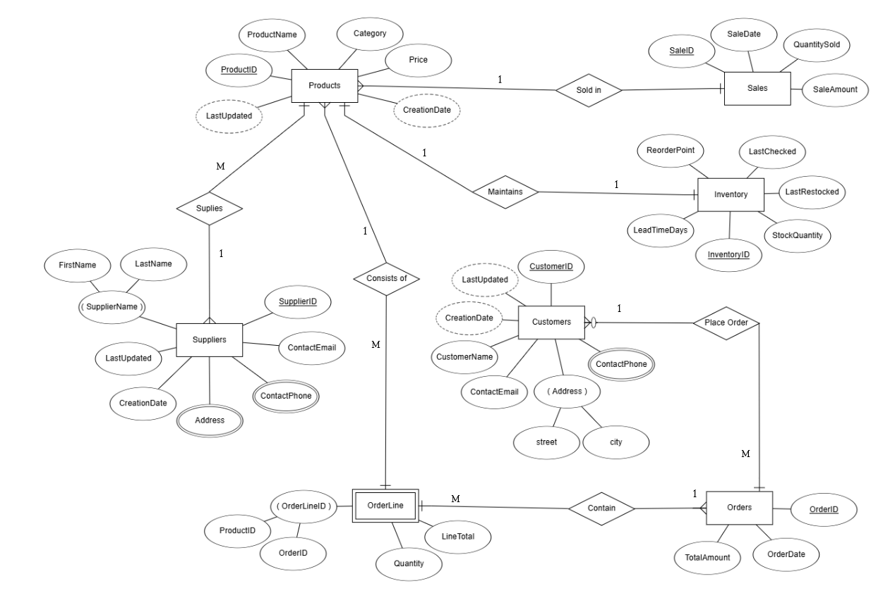
ERd

Slide 9
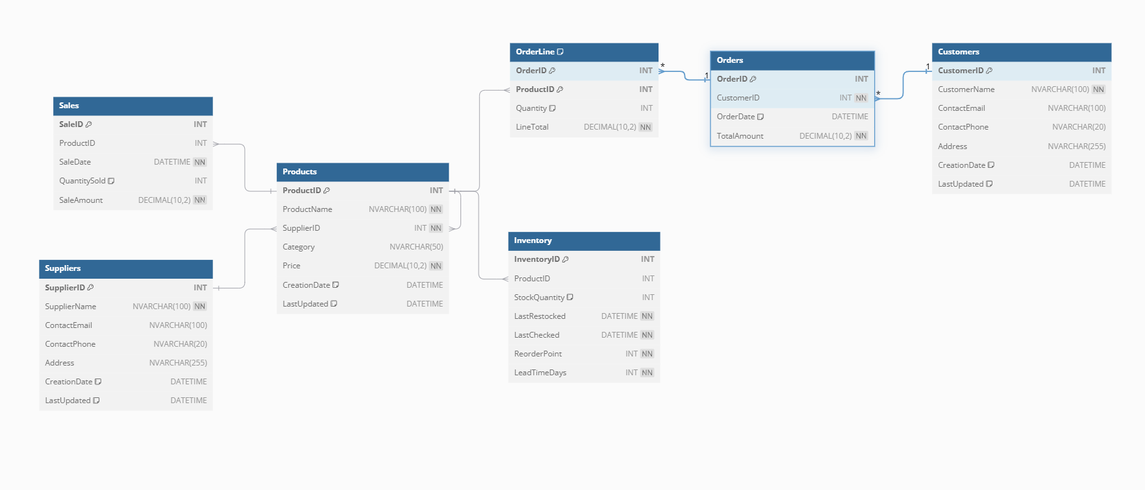
Database

Slide 10
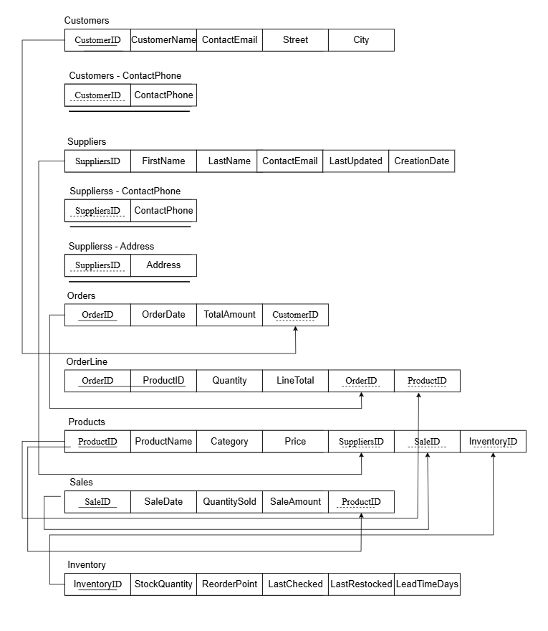
Logical diagram

Slide 11
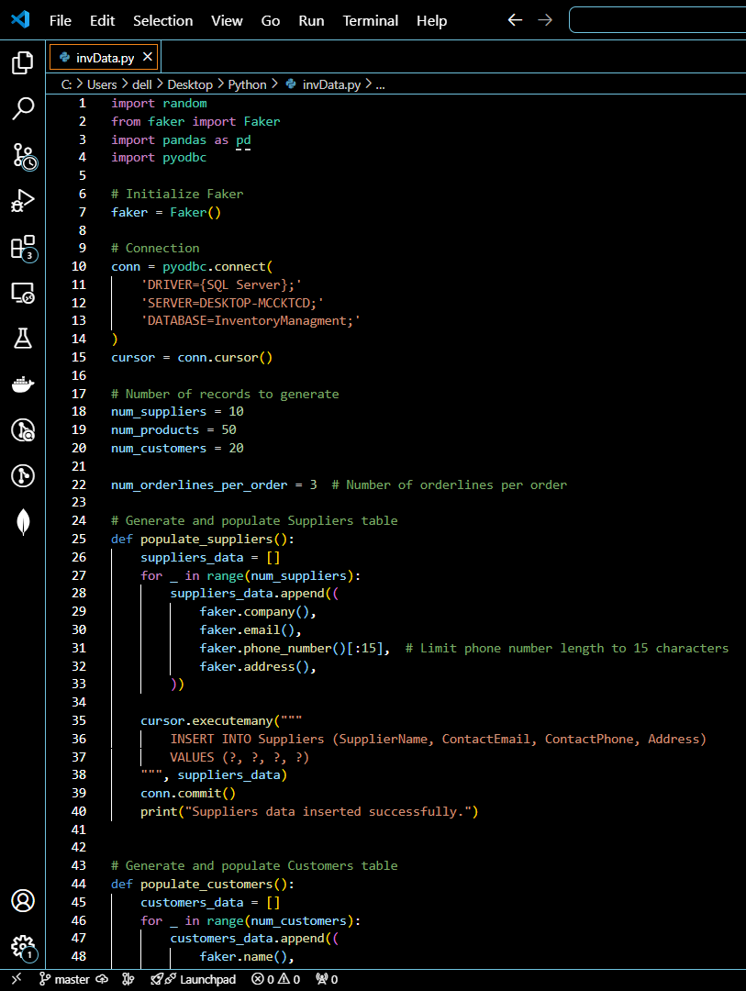
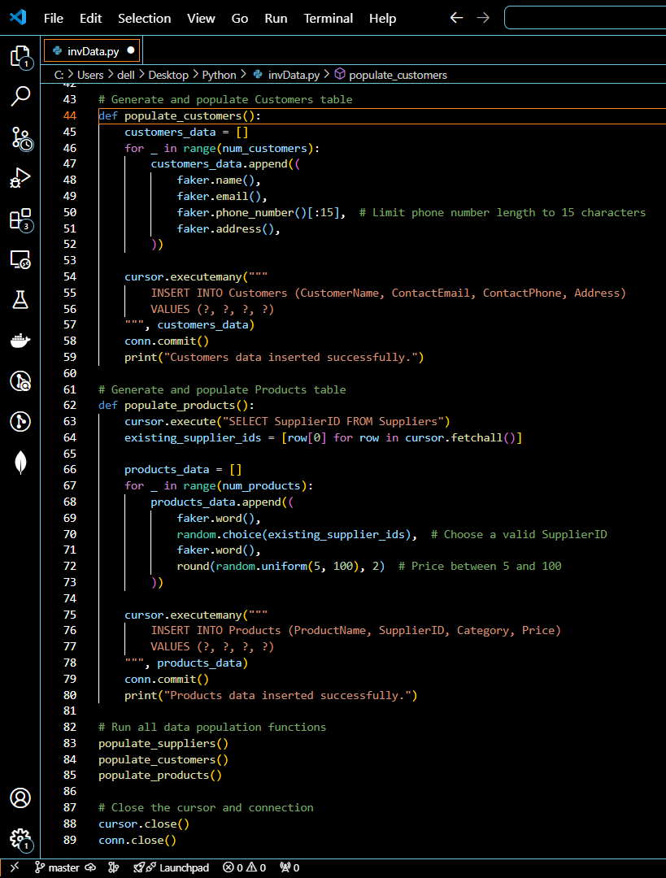
Generating dump data
python (Faker)

Slide 12
Business Questions
Answered with SQL queries for inventory tracking.
Are there seasonal fluctuations or patterns that we need to account for in our inventory and marketing strategies?
What should be the marketing focus? are the most popular products, and how much revenue do they generate?
How well are we managing inventory levels?
Which products are close to or already below the reorder point, and do we need to reorder these items to prevent stockouts and maintain availability?
Which products are contributing most to today's sales figures?
Can we identify patterns in customers purchasing behavior to help with targeted marketing or loyalty programs?
What products are provided by each supplier?
Who are our top-spending customers, and how can we incentivize them to continue purchasing from us or increase their loyalty?
Which product categories drive the most revenue, and should we focus more on expanding or promoting these categories?
Which suppliers provide the most stock and generate the most sales, helping us assess supplier performance and negotiate better terms?
How long have products been sitting in stock, and are there any slow-moving items or products that are overstocked?
Which customers have become inactive, and should we initiate a marketing campaign to re-engage them?

Slide 13
Data warehouse & azure connection

Slide 14
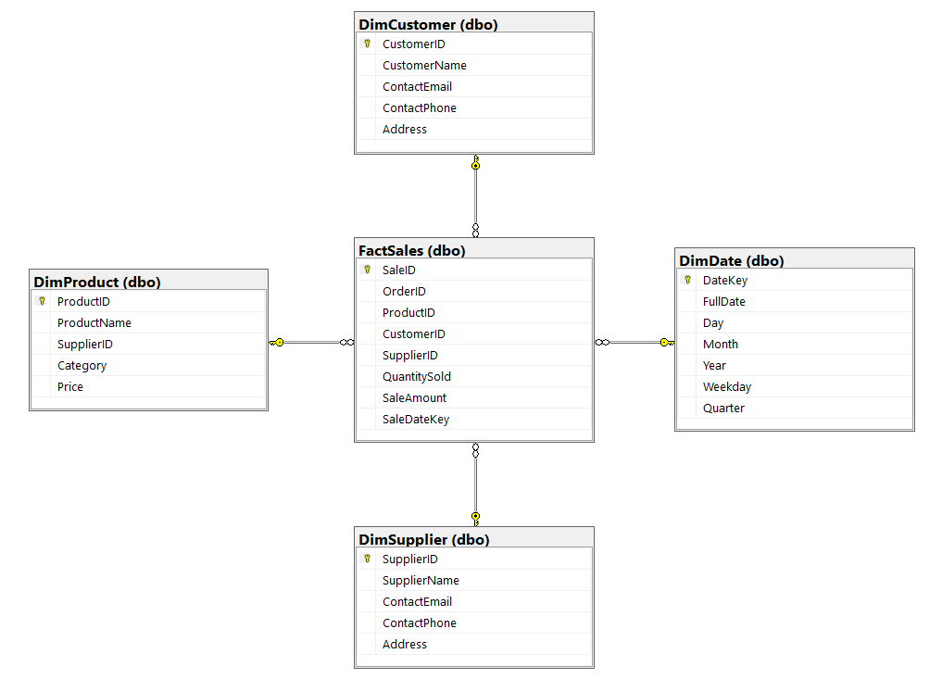
Data Warehouse Design
Schema Design :
Utilized Star Schema for efficient querying.
Fact Table: Stores transactional sales data.
Dimension Tables: store descriptive information that provides context for the data in the fact table.

Slide 15
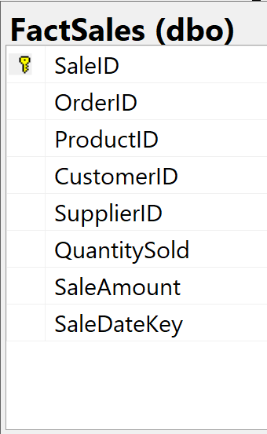
fact table
FactSales: The central transactional table that records each sale.
Key Attributes:
SaleID: Unique identifier for each sale.
OrderID: Identifier for the order associated with the sale.
ProductID: Links to the product sold (foreign key to DimProduct).
CustomerID: Links to the customer (foreign key to DimCustomer).
SupplierID: Links to the supplier of the product (foreign key to DimSupplier).
QuantitySold: The number of units sold.
SaleAmount: The total amount of the sale.
SaleDateKey: Date of the sale (foreign key to DimDate).

Slide 16
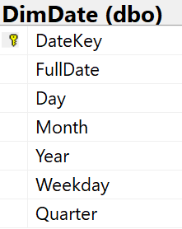
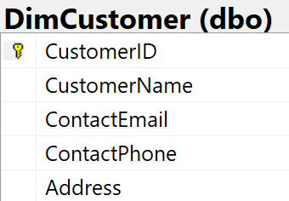
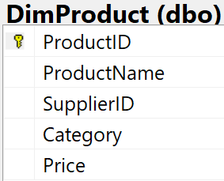
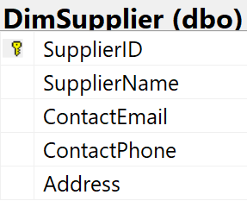
Dimension tables
DimDate: Stores calendar-related details to track and analyze sales over time.
DimCustomer: Holds customer details to analyze sales by customer demographics and behavior.
DimProduct: Contains information about products to analyze sales by product type and pricing.
DimSupplier: Stores supplier information to track product sourcing and supplier performance.

Slide 17
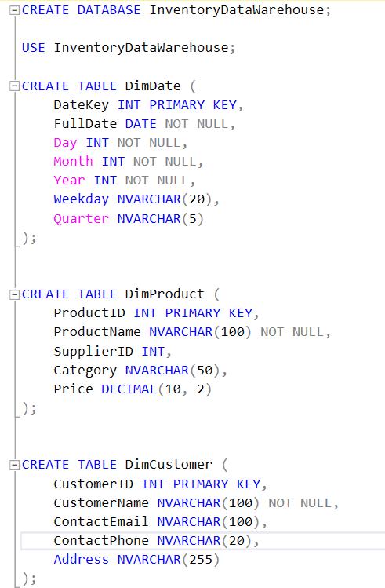
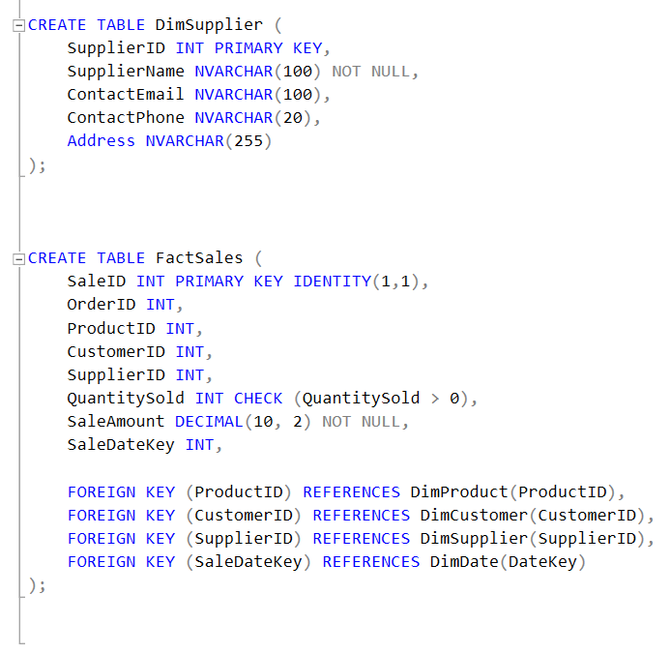
SQL Scripts

Slide 18
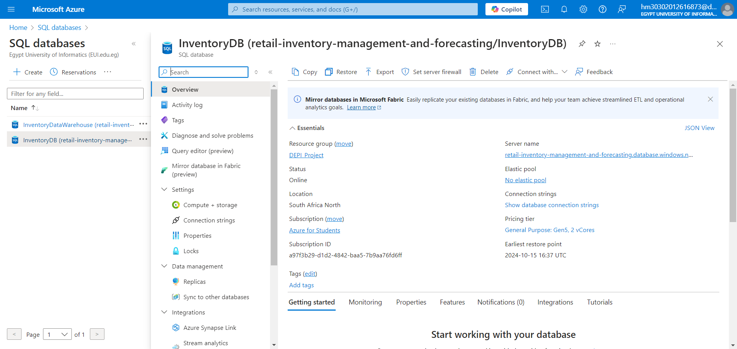
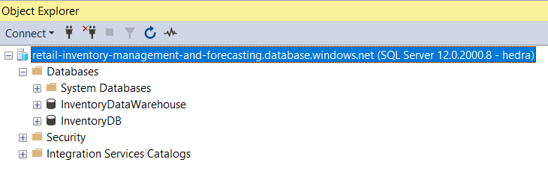
Azure Integration
Azure SQL Server:
Set up a secure connection with Azure SQL Database.
Configuration of InventoryDB and InventoryDataWarehouse on Azure for scalable cloud data management.
Azure Connection:
Connected SSMS to Azure for database management using SQL Server authentication.

Slide 19
ETL

Slide 20
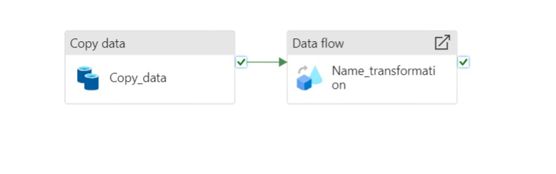
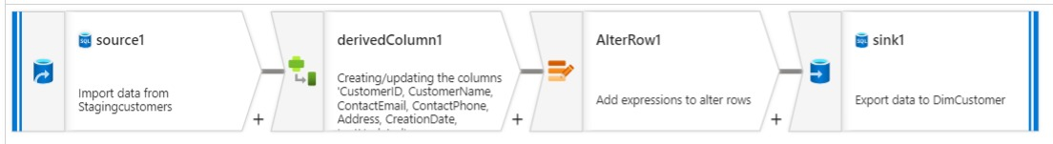

Slide 21
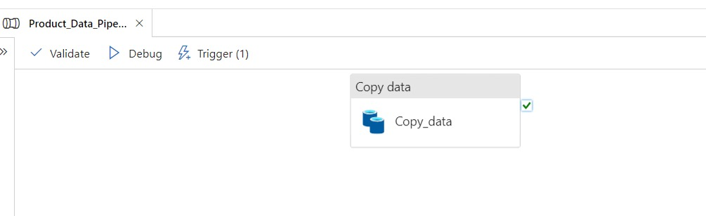
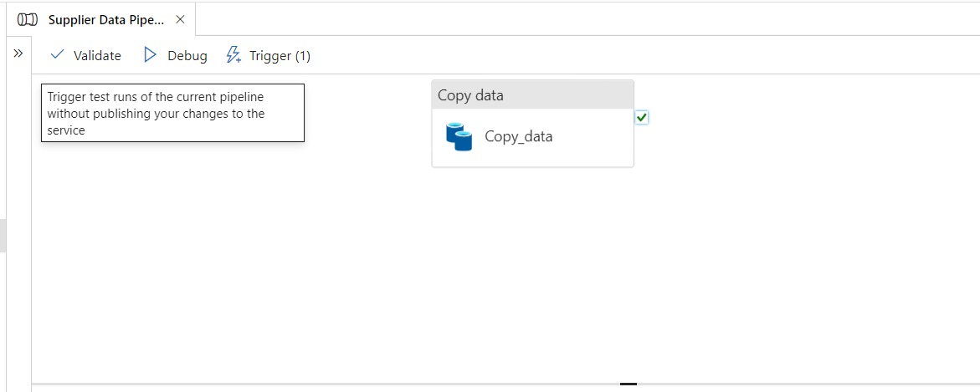

Slide 22
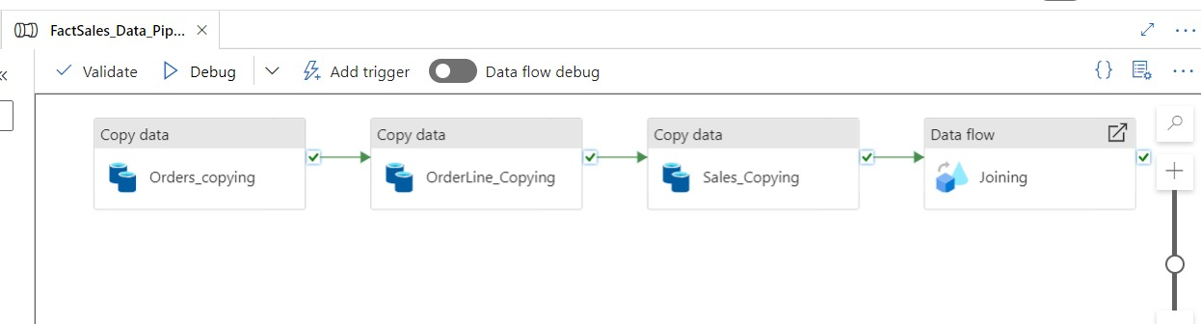

Slide 23
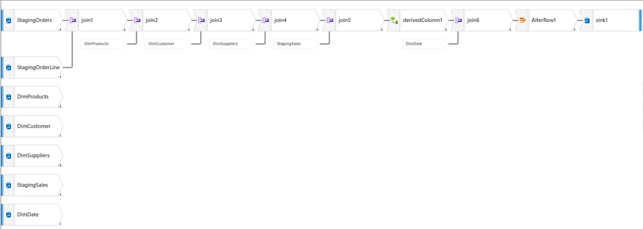

Slide 24
Data Preprocessing

Slide 25
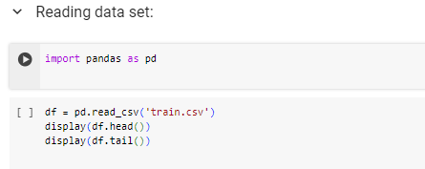
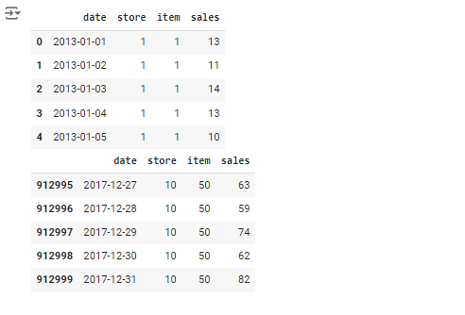
Data Preprocessing
Python script designed to transform raw sales data into a format suitable for further analysis. This process, known as data wrangling, is crucial for extracting valuable insights from our data.
We Have a vast dataset containing daily sales information from a retail chain. This script will guide us through cleaning and preparing this data for insightful analysis.
1. Accessing the Data:

Slide 26
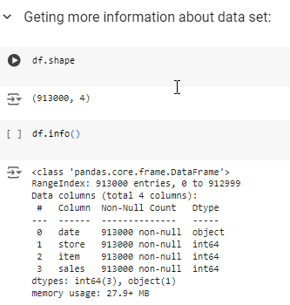
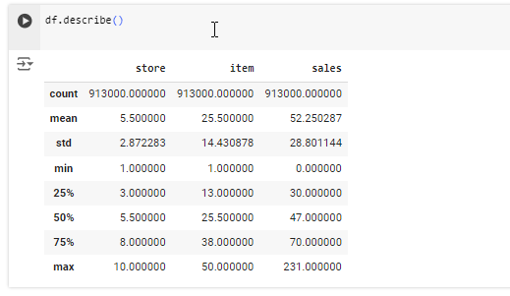
2. Exploring the Data Landscape :

Slide 27
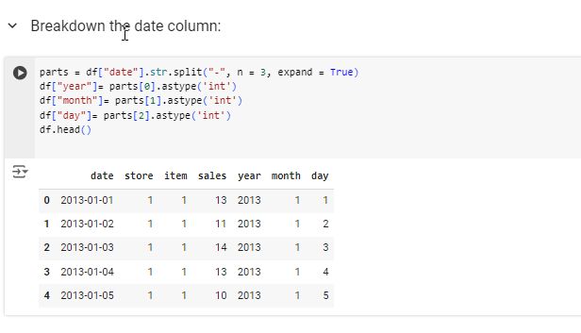
3. Breakdown of the Date Column:

Slide 28
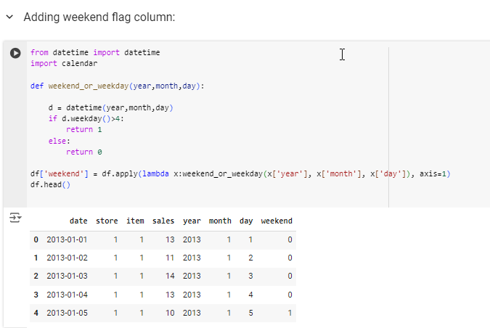
4. Adding weekend flag column:
Now, let's enrich our data by creating new features that will be helpful in analyzing sales patterns.

Slide 29
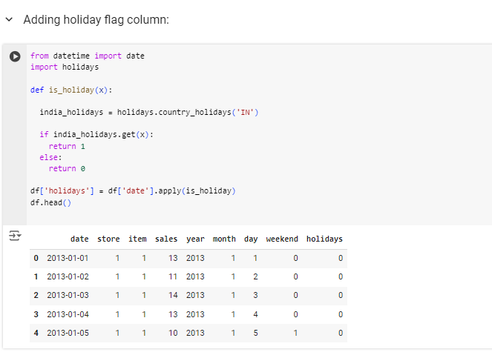
Adding holiday flag column:

Slide 30
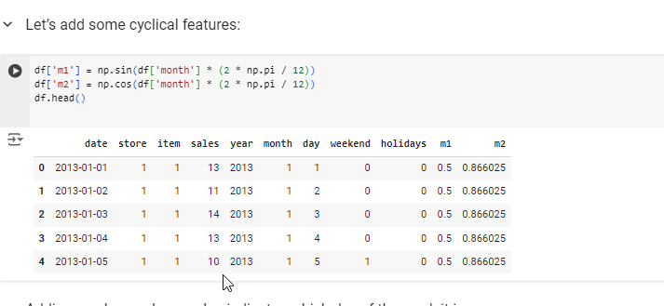
Let’s add some cyclical features:

Slide 31
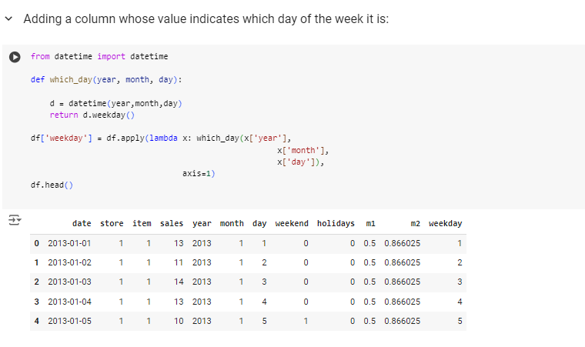
Adding a column whose value indicates which day of the week it is:

Slide 32
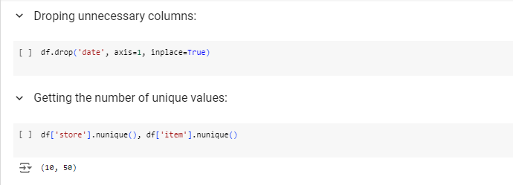
Let’s add some cyclical features:

Slide 33
MACHINE LEARNING MODEL

Slide 34
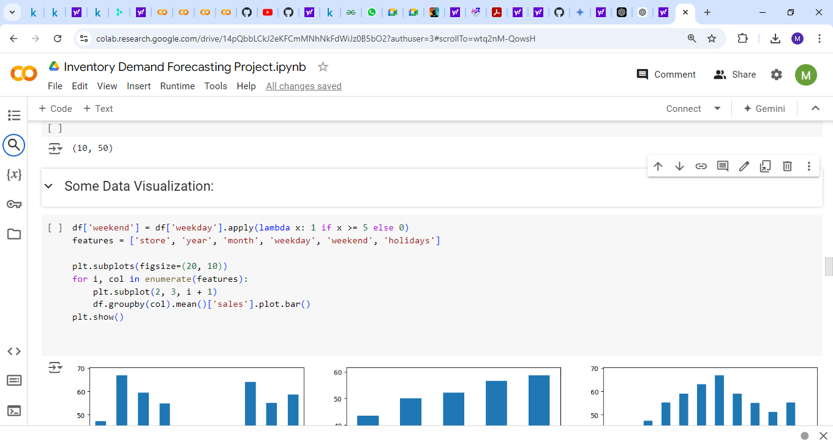
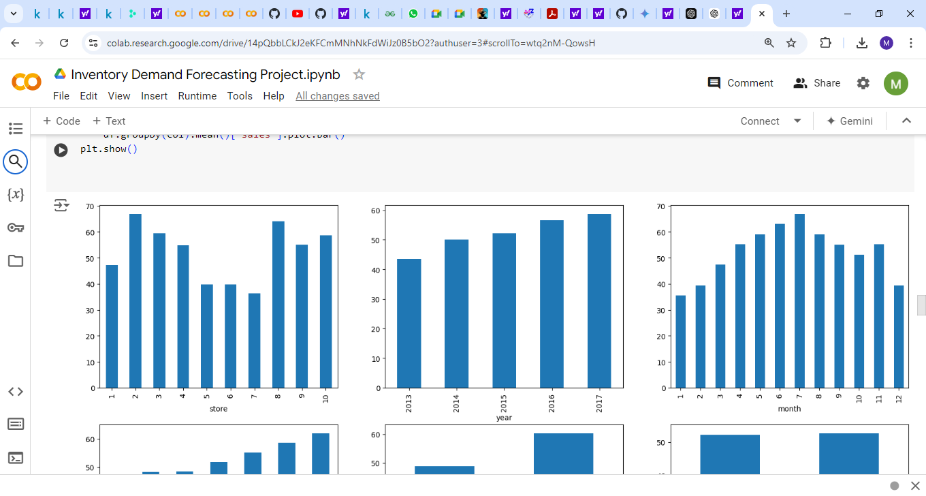
Data analysis
Sales vs. [store, year, month, weekday, weekend, holidays]

Slide 35
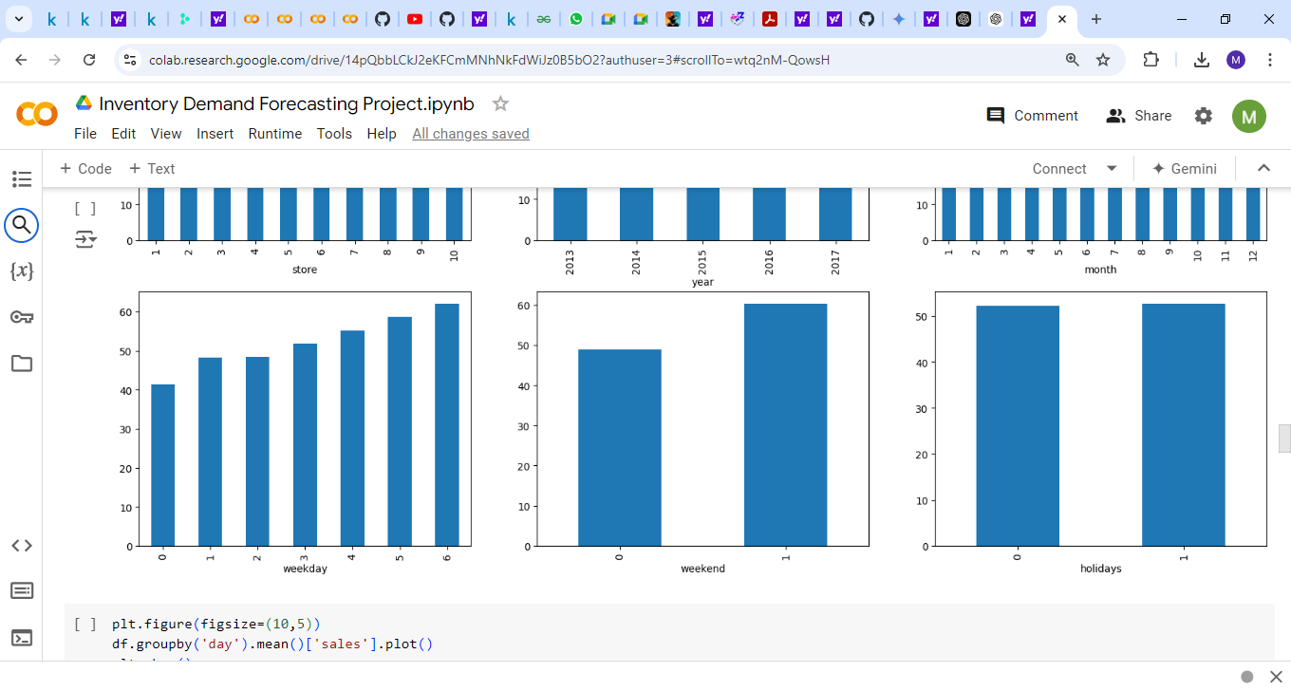
Data Analysis

Slide 36
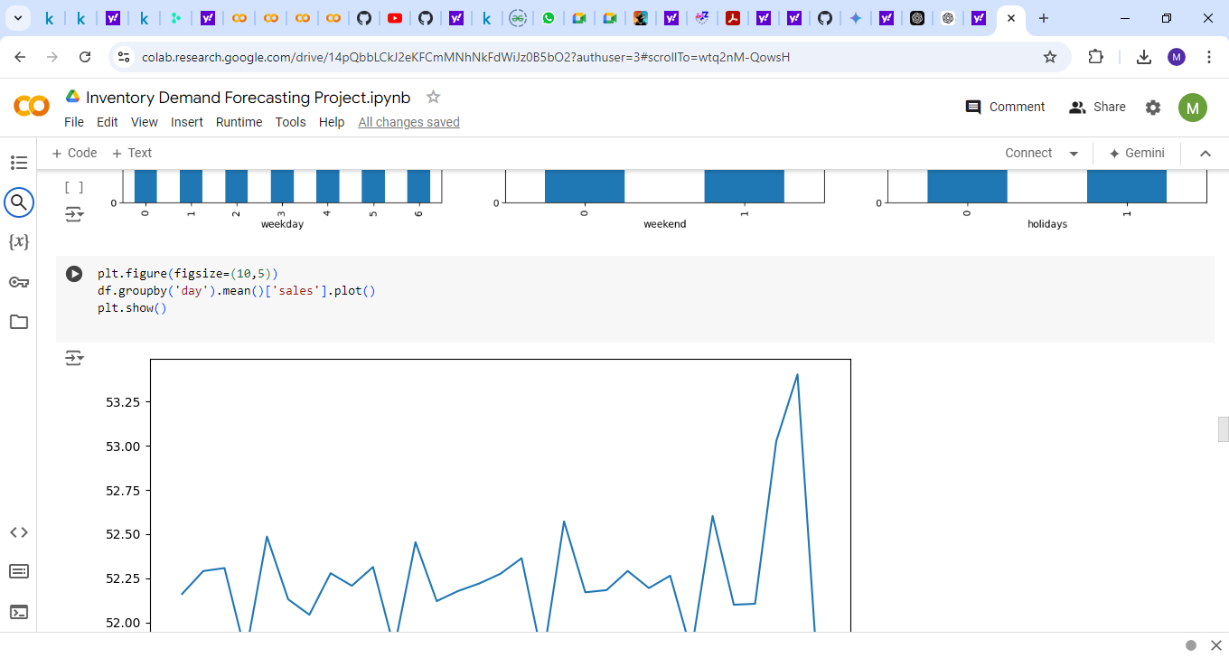
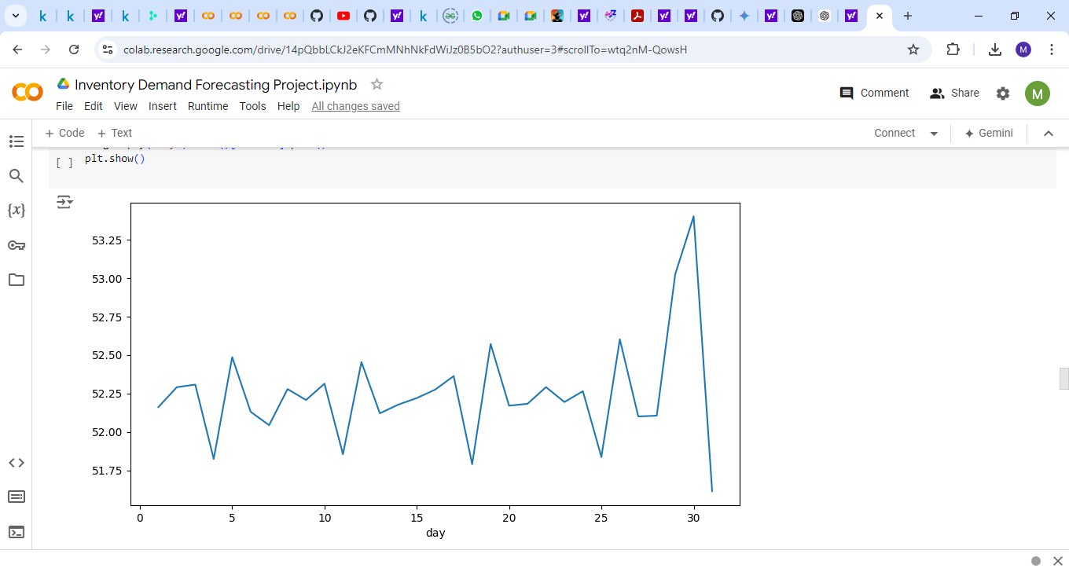
Data analysis
The average sales for each day of the month:

Slide 37
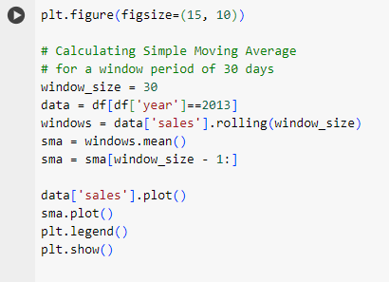
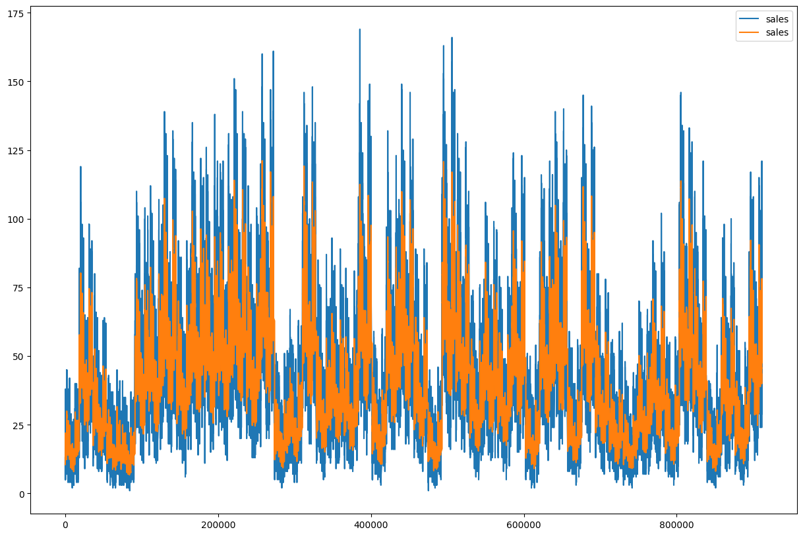
Data Analysis
Sales vs. Simple Moving Average

Slide 38
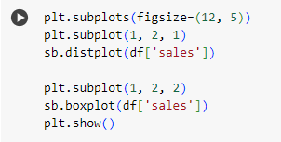
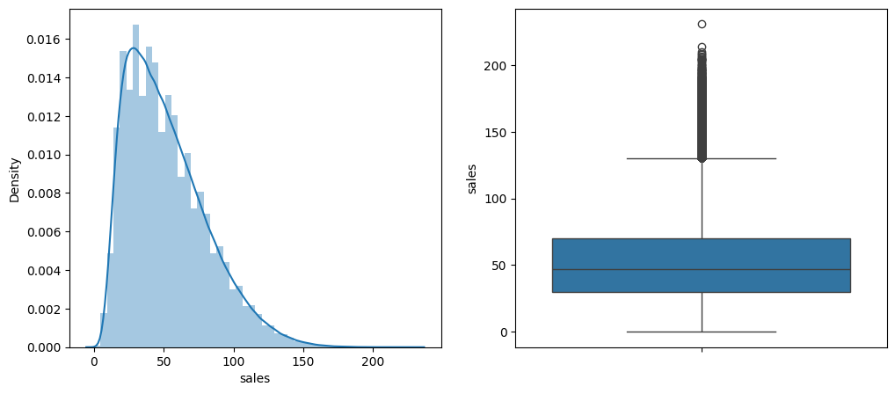
Data Analysis
The density of sales
(get the mean and outliers):

Slide 39
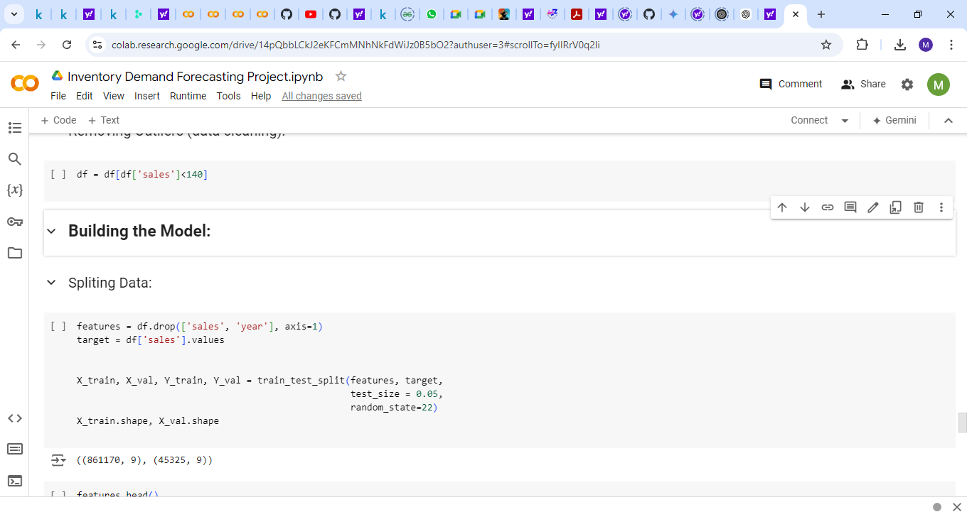
Building Models
Removing Outliers:
Splitting Data:

Slide 40
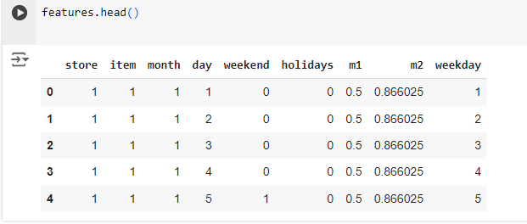
Building Models
Features Data Frame:

Slide 41
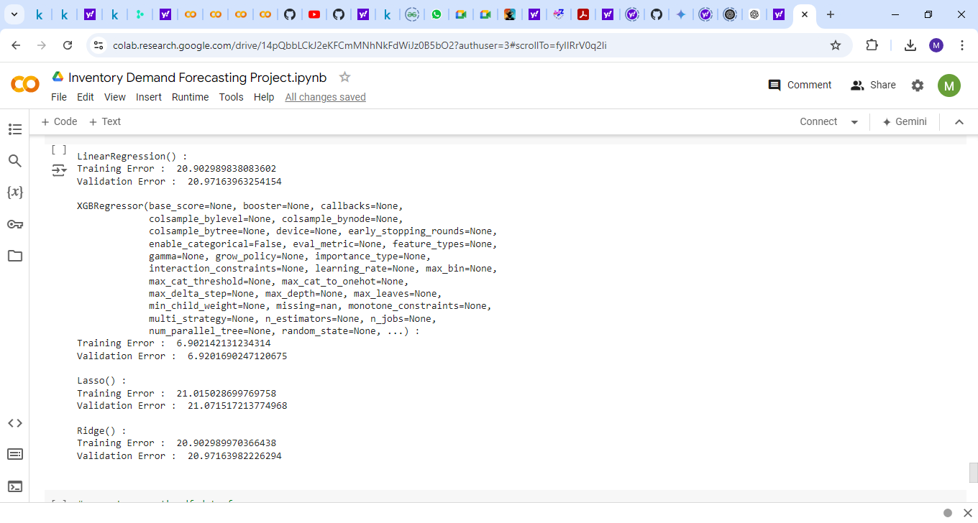
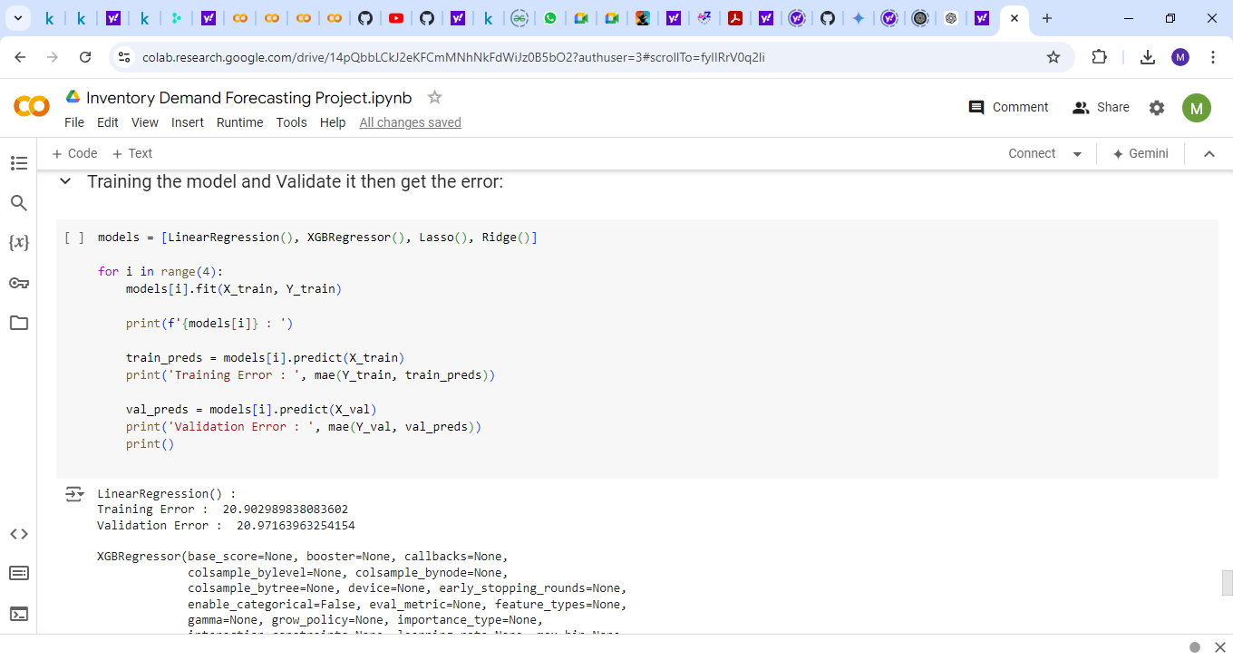
Building Models
Training Model:

Slide 42
Machine learning pipeline

Slide 43
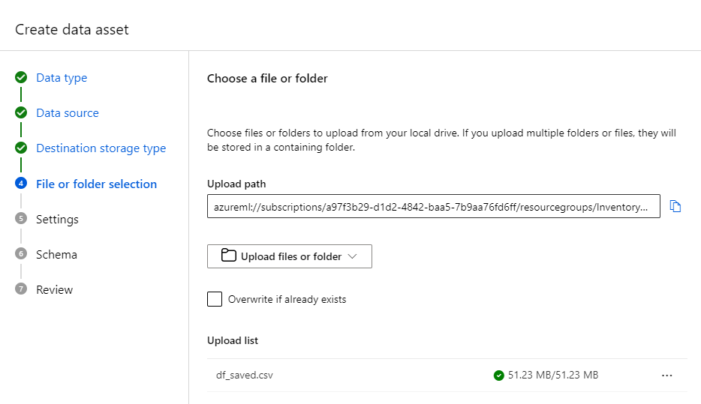
Upload Data Set

Slide 44
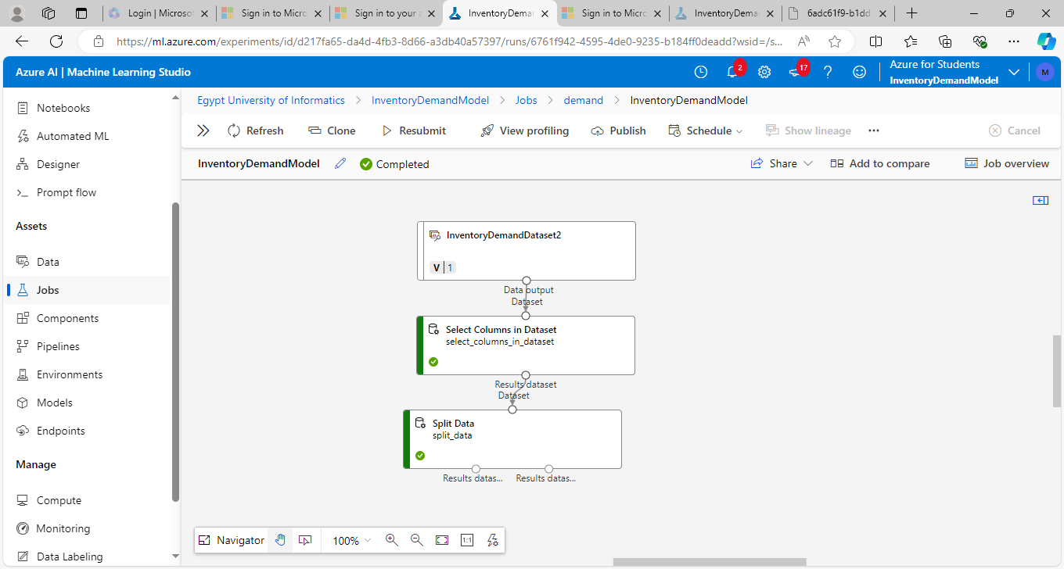
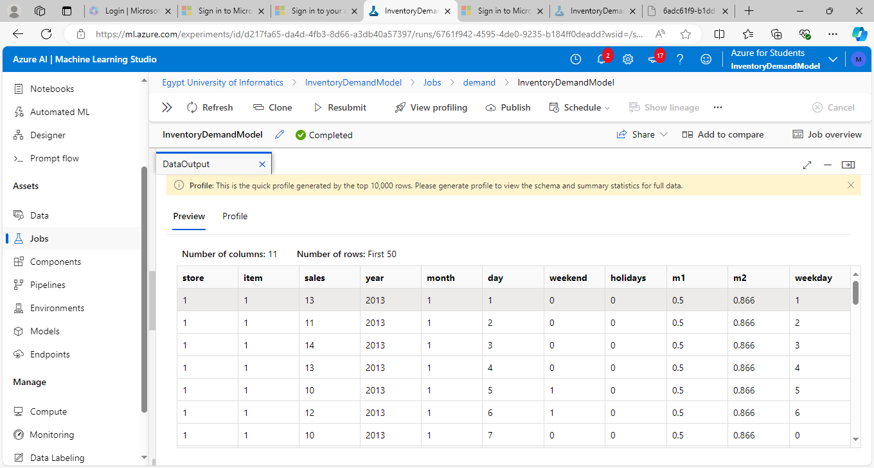
Upload Data Set

Slide 45
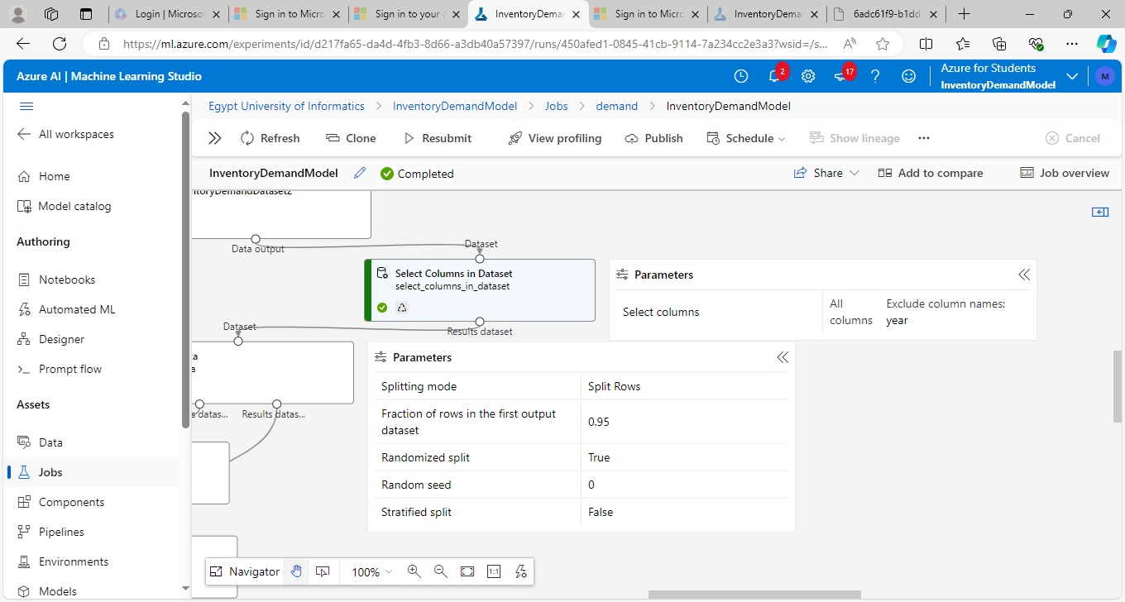
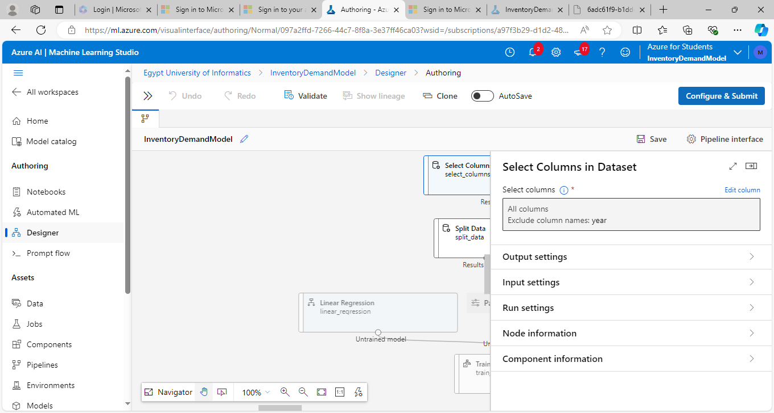
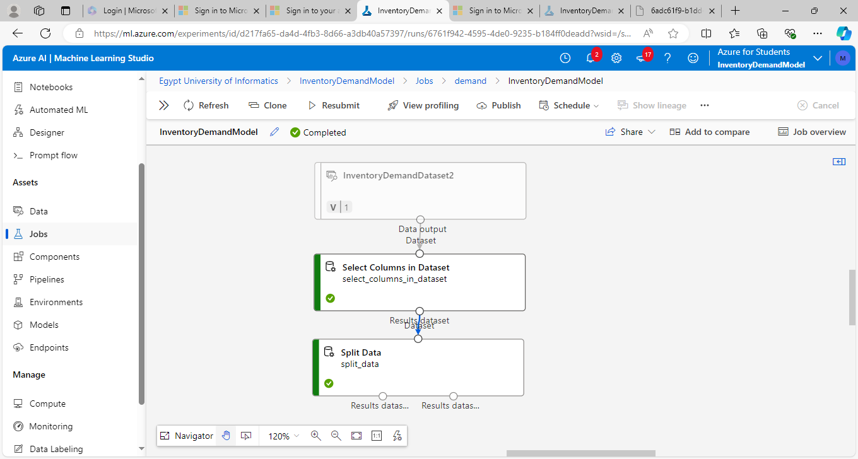
Select columns
Dropping ‘Year’ Column

Slide 46

Select columns

Slide 47

Split data set
Splitting the data set into training set and validating set with 0.95 fraction

Slide 48


Split Data set
Training Set
Validating Set

Slide 49



Train model
Training “Linear Regression” Machine Learning Model

Slide 50
Evaluate Model

Slide 51

Evaluate Model

Slide 52


Evaluate Model

Slide 53

Full pipeline

Slide 54
Data Visualization

Slide 55


Slide 56


Slide 57


Slide 58


Slide 59


Slide 60


Slide 61
Timeline
The project will be completed over two weeks:
3 Days: Database Design and Setup
Tasks:
Design the database schema, implement the database in SQL, and populate it with sample data.
Develop SQL queries for sales reporting, implement inventory tracking, and create real-time stock monitoring.
4 Days: Data Flow Automation
Tasks:
Implement Data warehouse setup, Use ETL to gather the data from different sources, transform it for consistency, and load it into the data warehouse for centralized analysis and reporting. Write Python scripts for data extraction and preparation for Analysis.
4 Days: Forecasting Model Development
Tasks:
Build and test the predictive Forecasting model using historical data.
Utilize Azure cloud services to store the database and run the forecasting model.
2 Days: Visualizing and Documenting
Tasks:
Generate insights and reports that assist in decision-making.
Build dashboard for users to view inventory levels, sales trends, and forecast reports.
Complete the final report and prepare for the project presentation.

